Slide 1
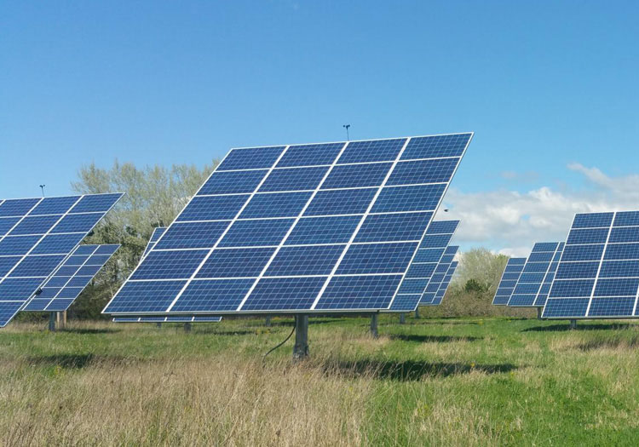
Project Name : Automated Solar Panel

Slide 2
PRESENTED BY:-
NAME ROLL NO.
KOUSTAV DHARA L-24
VAIBHAW SINHA L-30
HEMANT TIWARY L-35
JUBER ALI L-37
TANMOY DE L-29

Slide 3
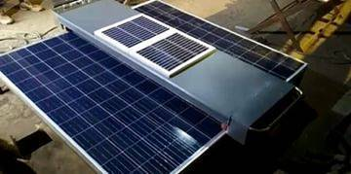
TABLE OF CONTENTS
Introduction
Components required
Ardunio Uno
Solar panel
LDR
Servo Motors
Working principle and circuit design
Circuit Diagram
Setup
Applications
Project Code
Conclusions
References

Slide 4
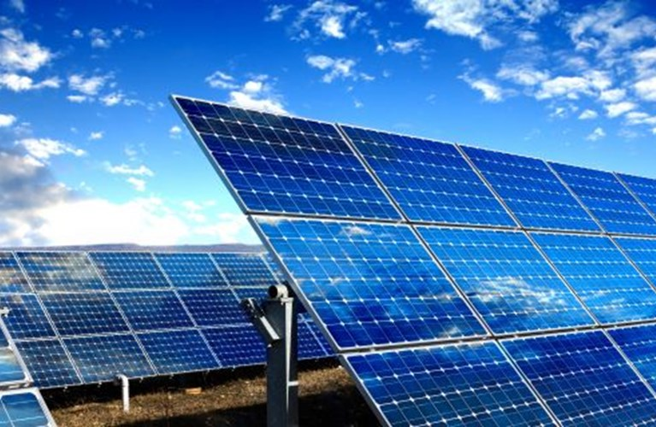
INTRODUCTION
As the non renewable energy source are decreasing ,use of renewable resources for producing electricity is increasing day by day.
Solar Panel absorbs energy from Sun, converts the energy it into electrical energy in a battery.
The energy can be utilized when required or can be used as a direct alternative for grid supply.
The position of the Sun with respect to the solar panel is not fixed due to rotation of Earth. For efficient use of energy a solar panel must absorb the solar energy to a maximum extent.
This can be done if there is a circuit which move the panels & continuously placed itself towards the direction of the Sun. This article describes the circuit which rotates the panel.

Slide 5
COMPONENTS REQUIRED
Arduino UNO-1
Servo motor-2
Photo diode-4
Voltage regulator 7805 IC
1k Resistor-4

Slide 6
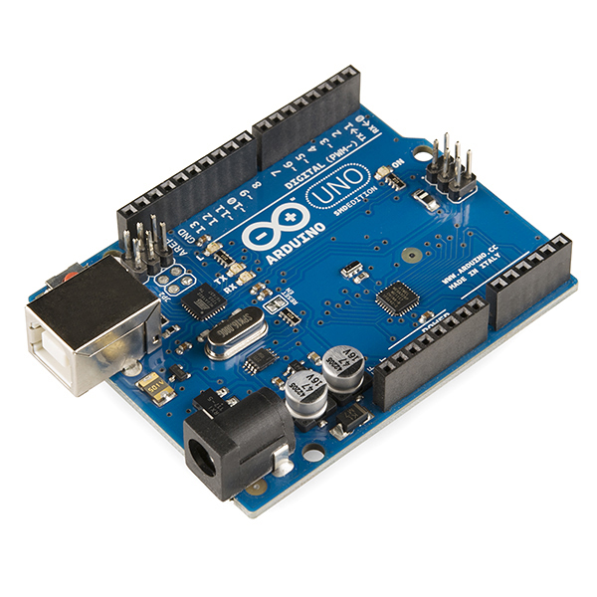
ARDUINO UNO
The Arduino Uno is an open-source microcontroller board based on the Microchip ATmega328P microcontroller and developed by Arduino.cc. The board is equipped with sets of digital and analog input/output (I/O) pins that may be interfaced to various expansion boards (shields) and other circuits.^{[1]} The board has 14 digital I/O pins (six capable of PWM output), 6 analog I/O pins, and is programmable with the Arduino IDE (Integrated Development Environment), via a type B USB cable.^{[4]} It can be powered by the USB cable or by an external 9-volt battery, though it accepts voltages between 7 and 20 volts.

Slide 7
Arduino Uno has following technical significance:
Microcontroller: ATmega328P
Operating Voltage: 5 volts.
Input Voltage: 7 to 20 volts.
Digital pin: 14 pins.
UART: 1.
12C: 1.
SPPI: 1.
Analog Input Pins: 6.
DC Current pin per I/O pin: 20mA.
DC Current for 3.3V Pin: 50mA.
Flash Memory: 32 KB
SRAM: 2KB
EEPROM: 1 KB.
Clock Speed: 16 MHZ.
Length: 68.6 mm.
Width: 53.4 mm.
Weight: 25 g.

Slide 8
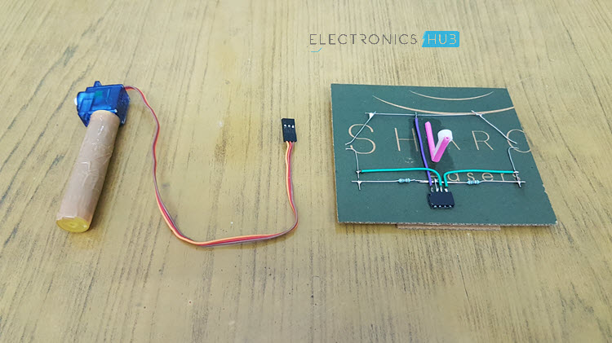
Solar Panel
Solar panel is placed on a piece of cardboard (just for demonstration) and the bottom of the cardboard is connected to Servo motor. Solar panel consists of photovoltaic cells arranged in an order. Photovoltaic cell is nothing but a solar cell. Solar cell is made up of semiconductor material silicon.
When a light ray from Sun is incident on the solar cell, some amount of energy is absorbed by this material. The absorbed energy is enough for the electrons to jump from one orbit to other inside the atom. Cells have one or more electric field that directs the electrons which creates current. By placing metal contact energy can be obtained from these cells.

Slide 9
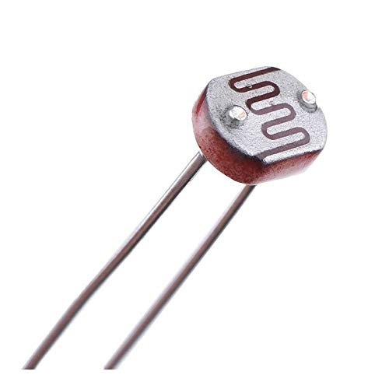
LIGHT DEPENDENT RESISTORS
LDR
Light Dependent Resistors or LDRs are the resistors whose resistance values depend on intensity of the light. As the intensity of light falling on the LDR increases, resistance value decreases. In dark, LDR will have maximum resistance. LDR will output an analog value which should be converted to digital. This can be done using analog to digital converter.

Slide 10
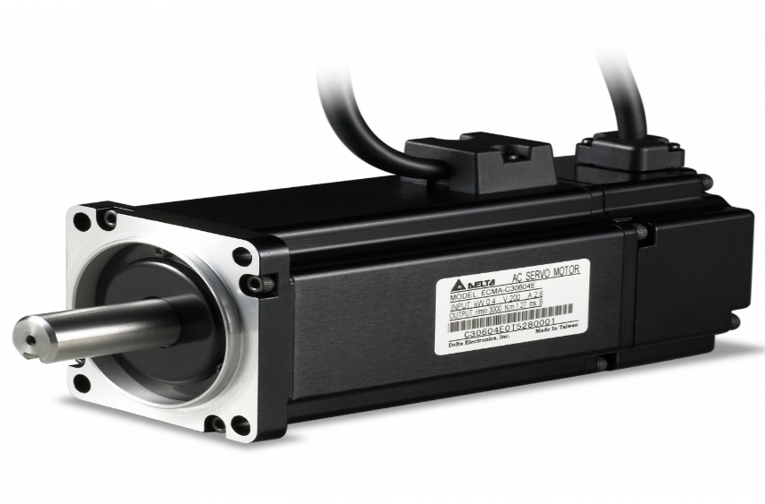
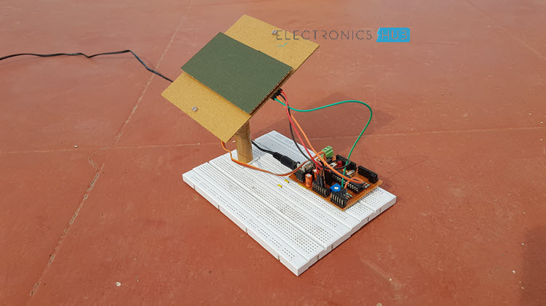
SERVO MOTOR
Servo motor is used to rotate the panel. To drive the servo motor, a PWM Signal must be provided to its control pin and hence Pin 17 (which has PWM) is connected to the control pin of the servo motor.
By connecting a battery to the solar panel, you can store the energy generated by the solar cells and this energy can be used when required. There are separate charge controller circuits dedicated to efficiently control the charge acquired from solar panels and charge the batteries.

Slide 11
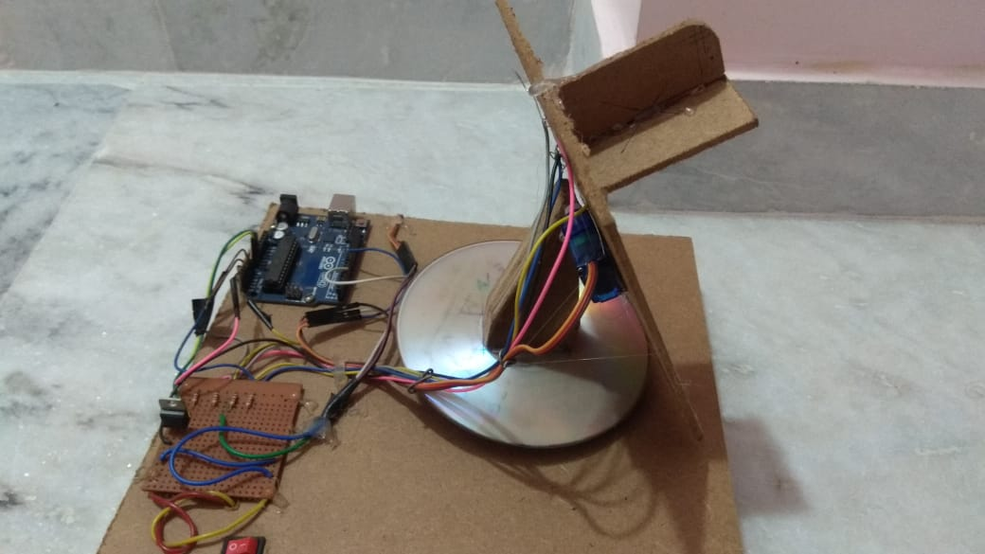
WORKING PRINCIPLE AND CIRCUIT DESIGN
The Sun tracking solar panel consists two LDRs, solar panel and a servo motor and ATmega328 Micro Controller.
Two light dependent resistors are arranged on the edges of the solar panel. Light dependent resistors produce low resistance when light falls on them. The servo motor connected to the panel rotates the panel in the direction of Sun. Panel is arranged in such a way that light on two LDRs is compared and panel is rotated towards LDR which have high intensity i.e. low resistance compared to other. Servo motor rotates the panel at certain angle.
When intensity of light is more in the left LDR the panel will move to left side if intensity of light is more in the right side then vice versa happen. If intensity of light is same on both side no rotation happen.

Slide 12
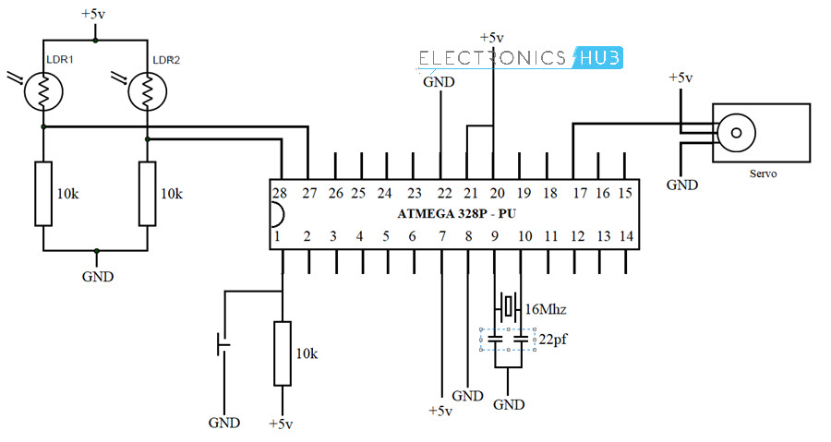
Circuit Diagram

Slide 13
SETUP
Setup Step-1 Take cardboard. Make a hole in the middle and four holes on four sides so that photo diode fit into that. Stick the solar panel to the cardboard and bring two wires of the panel out as shown.
Step-2 Now cut one of the two leads of the photo diode so that one lead is shorter and other is longer. Insert these four photo diodes into four holes as shown. Bend the straight Perforated metal strip as shown below. Place the bent metal strip on the back side of the cardboard Apply glue to the photo diode to fix them firmly.
Step-3 Solder the two leads of photo diode as shown To the other ends of photo diode Solder resistors of 1k ohm Join the four leads of the 4 photo diodes by connecting with a wire.
Step-4 Now take a bus wire. This is used to connect the Outputs of four photo diodes to Arduino board. Insert it into metal strip as shown in the image. Now Solder the four wires to four photo diodes at any point between photo diode and resistor.

Slide 14
Step-5 Insert another two wire bus into the perforated metal strip as shown. This is used for supplying Vcc and GND to circuit. Solder one wire to the leads of photo diodes which are connected to resistors and other wire to the other leads. Short the leads of photo diodes connected to resistors using a wire as shown.
Step-6 Now connect a servo motor to the Perforated metal strip using Screw. Apply glue to the servo to fix it firmly.
Step-7 Take another straight Perforated metal strip and bend it as shown in the figure.
Step-8 Now place the set up of solar panel and first servo motor to the metal strip of second servo motor as shown.

Slide 15
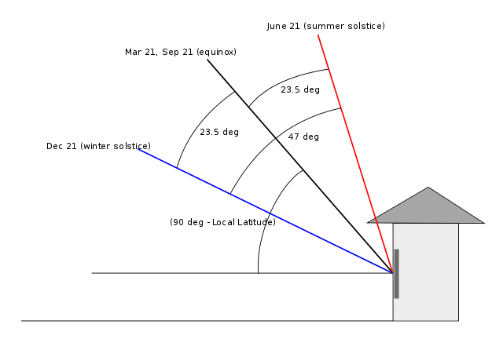
APPLICATIONS
Scientists and engineers are trying to increase the efficiency of solar cells and decrease the expense. Trackers were considered practical when solar cells were very expensive. Now prices have come down so much that the emphasis is on large areas of fixed panels and on covering all available building surfaces with panels. Concentrating solar thermal collectors use hundreds of mirrors which rotate to reflect light to central power tower. Solar thermal trackers are still relevant because they have the potential to store energy with molten salts for several hours after sun down. This helps deliver solar generated power in the evening when demand peaks.

Slide 16
PROJECT CODE
//Single axis solar tracker program
#include <Servo.h> // loads the servo library
Servo myservo; // create servo object to control a servo
int pos = 90; // variable to store the servo position 0-180
int sensorPin = A0; // select the input pin for the potentiometer
int sensorPin2 = A1;
int sensorValue = 0; // variable to store the value coming from the sensor
int sensorValue2 = 0;
int diffval = 0;
int errorval = 15;
void setup()
{
myservo.attach(9); // attaches the servo on pin 9 to the servo object
//Serial.begin(9600); // uncomment if you need to measure outputs with the serial monitor.
}
void loop() {
sensorValue = analogRead(sensorPin);
sensorValue2 = analogRead(sensorPin2);
diffval = sensorValue – sensorValue2;
if (abs(diffval) > errorval) {
if (diffval > 0) {
pos = pos + 5;
}
else {
pos = pos – 5;
}
myservo.write(pos);
delay(100);
}

Slide 17
Conclusion
These panels can be used to power the traffic lights and streetlights
These can be used in home to power the appliances using solar power.
These can be used in industries as more energy can be saved by rotating the pane

Slide 18
REFERENCE
Google
Wikipedia
& Youtube.

Slide 19
Thank You

